Slide 1
E_HOSPITAL (Mini Project)
Presented by:- Priyanka Pandey
MCA 2nd year
KIET Group of Institutions

Slide 2
Introduction
The project E_Hospital includes registration of patients, storing their details into the system.
The software has the facility to give a unique id for every patient and stores the details of every patient and the staff automatically.
User can search availability of a doctor and the details of a patient using the id.

Slide 3
System Specifications
H/W Requirement
Core i5 processor
2GB Ram.
20GB of hard disk space in terminal machines
1TB hard disk space in Server Machine
S/W Requirement
Windows 7 or above operating system
JRE 1.8
Mysql server, Apache

Slide 4
Communication Interfaces
NIC (Network Interface Card) – It is a computer hardware component that allows a computer to connect to a network. NICs may be used for both wired and wireless connections.
CAT 5 network cable- for high signal integrity
TCP/IP protocol- Internet service provider to access and share information over the Internet
Ethernet Communications Interface- Ethernet is a frame-based computer network technology for local area networks (LANs)
Ubiquitous(widespread), easy to set up and easy to use. Low cost and high data transmission rate.

Slide 5
Product Functions
Provide access to registered users only.
Registration of new patients.
Enable patient to view their record.
Enable patient to update their record.
Generate appointment date and timing.
Confirmation by doctor.
Patients can do Payment.
Modification in schedule by patient.
Admin access to patient’s record.
Admin can view monthly/yearly records.

Slide 6
S.No. | MODULE NAME | APPLICABLE ROLES | DESCRIPTION
1. | LOGIN | PATIENT,DOCTOR, ADMIN | PATIENT: Can login using unique Id and Password after this system shall show his/her profile. DOCTOR: Can login using unique Id and Password after this system shall show his/her profile. ADMIN: Can login using unique Id and Password after this system shall show a profile with links to maintain the website.
2. | REGISTRATION | PATIENT | PATIENT: Can Register by filling all the required details, after this the system will verify the details and check if already registered or not.
3. | MAKE APPT. | PATIENT | PATIENT: Can Select doctor, date time and make an appointment request after this system shall show a confirmation for appointment request.
4. | CANCLE APPT. | PATIENT, DOCTOR , | PATIENT : Can Cancel appointment if want to by just one click after this system shall ask for re-schedule or refund of payment. DOCTOR : Can Cancel appointment if want to by just one click after this system shall send a message to the patient.

Slide 7
5. | PAYMENT | PATIENT | PATIENT : Enter payment details and make payment after this system shall show the generated bill by the hospital.
6. | DOCTOR MODULE | ADMIN | ADMIN : Can add a new doctor by filling all the details after this system shall show a confirmation message. Can Remove a doctor by just one click after this system shall show confirmation message.
7. | PATIENT MODULE | PATIENT | PATIENT : Can view payment history or can search for a particular bill also after this system shall show a bill or history. Can also See or search for a doctor by entering dept. name or doctor id if known after this system will check for the doctor if found shall show doctor’s profile. Can also update details after this system shall ask for re-enter password and after verifying password shall update details.
8. | ADD PRESCRIPTION | DOCTOR | DOCTOR : Enter Patient Id and after this all the treatment details and medicine, remark and advice for the patient after this system shall show a message for update.

Slide 8
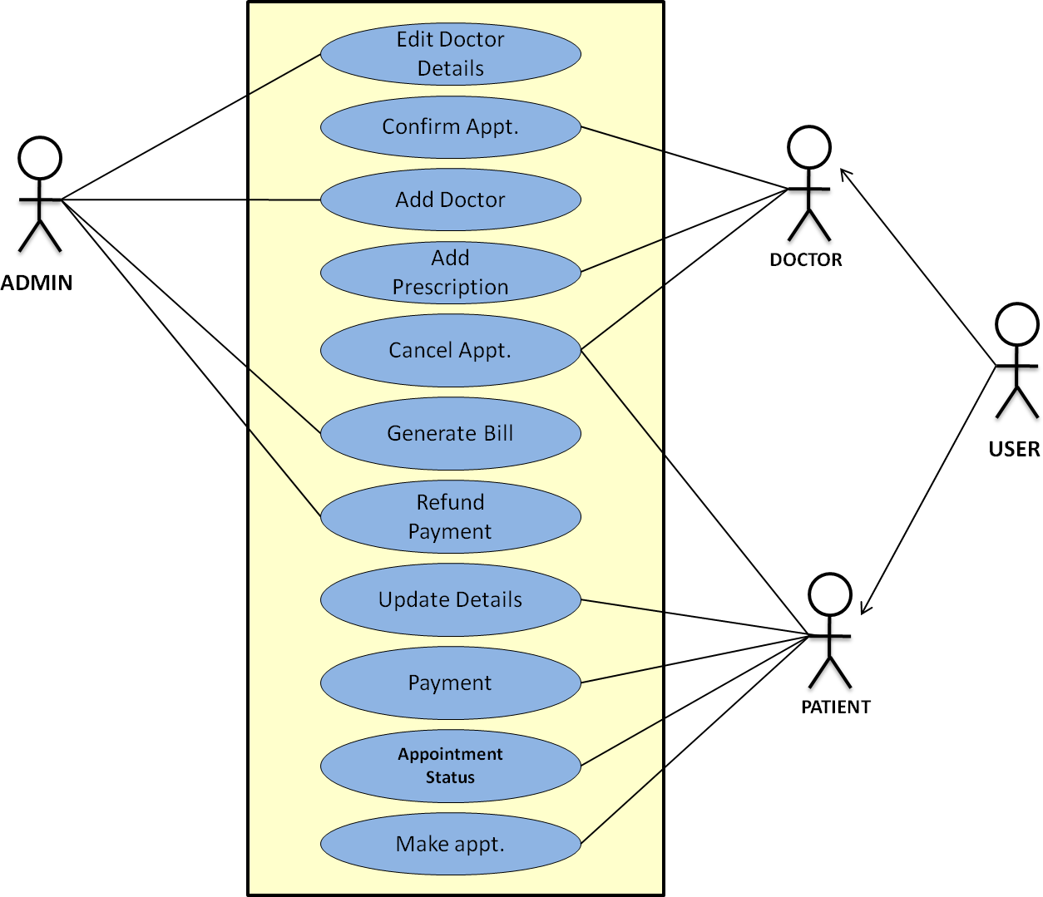
Use Case Diagram

Slide 9
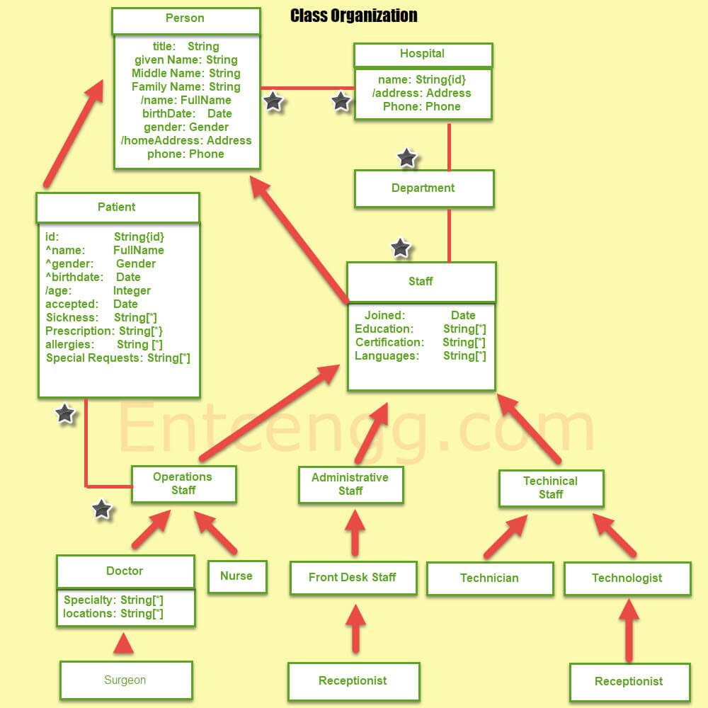
Class Diagram

Slide 10
References
https://www.adroitinfosystems.com/products/ehospital-systems/#:~:text=Patient%20Registration%20module%20of%20eHospital,%2C%20employer%2C%20and%20insurance%20information.
https://mscw.ac.in/NAAC/Criteria1/Samples-of-ProjectWork_Fieldwork/Computer_Science/software_Engineering/Software%20Engineering/Hospital%20Managment%20Project%20SE-converted.pdf
https://skill-lync.com/student-projects/project-design-a-hospital-management-system-4

Slide 11
THANK YOU

